Slide 1
Chap#6
Protecting the idea and other legal issues for the Entrepreneur

Slide 2
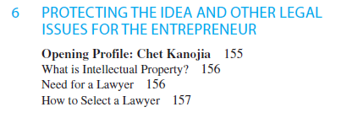
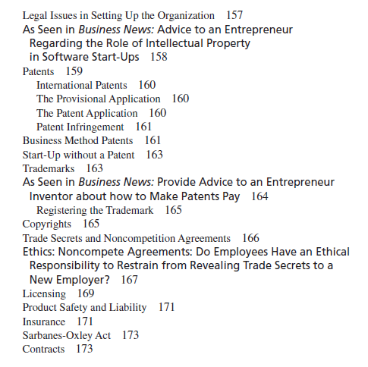

Slide 3
WHAT IS INTELLECTUAL PROPERTY?
Intellectual Property—which includes patents, trademarks, copyrights, and trade secrets—represents important assets to the entrepreneur and should be understood even before engaging the services of an attorney. Too often entrepreneurs, because of their lack of understanding of intellectual property, ignore important steps that they should have taken to protect these assets.
NEED FOR A LAWYER: business is regulated by law, entrepreneur will need legal advice.
HOW TO SELECT A LAWYER: specialists in field, risks handler, more up-front about their fees, good working relationship, resources are very Limited in start,Once the patent is obtained this lawyer would not be needed, competent attorney is in a better position to understand all possible circumstances and outcomes related to any legal action.

Slide 4
LEGAL ISSUES In SETTING UP THE ORGANIZATION
Legal advice for these agreements is necessary to ensure that the most appropriate decisions have been made.
understand all the advantages and disadvantages of each regarding such issues as liability(Quality), taxes, continuity, transferability of interest, costs of setting up, and attractiveness for raising capital.

Slide 5
PATENTS
Grants holder protection from others making, using, or selling a similar idea. Patent is a contract between the government and an inventor.
Utility patents: A utility patent has a term of 20 years, beginning on the date of filing with the Patent and Trademark Office (PTO). A utility patent basically grants the owner protection from anyone else making, using, and/or selling the identified invention and generally reflects protection of new, useful, and unobvious processes.
Design patents: Covering new, original, ornamental, and unobvious designs for articles of manufacture, a design patent reflects the appearance of an object. These patents are granted for a 14-year term.
Plant patents: These are issued under the same provisions as utility patents and are for new varieties of plants. These patents represent a limited area of interest.

Slide 6
International Patents
As international marketing increases in our age of rapid technological development.
The USPTO has established the Office of International Patent Cooperation in order to decrease the uncertainty of IP rights while also reducing costs. Its role is to move toward a much more harmonized patent system.
The Provisional Application
Entrepreneur first file a provisional patent application to establish a date of conception of the invention.
The Patent Application
The patent application must contain a complete history and description of the invention as well as claims for its usefulness.
Introduction This section should contain the background and advantages of the invention and the nature of problems that it overcomes. It should clearly state how the invention differs from existing offerings.
Description of invention Next the application should contain a brief description of the drawings that accompany it.
Claims This is probably the most difficult section of the application to prepare since claims are the criteria by which any infringements will be determined.
Notes:
Infringement: violation

Slide 7
Checklist for Minimizing Patent Risks
Seek a patent attorney who has expertise in your product line.
• The entrepreneur should consider a design patent to protect the product design or product look.
• Before making an external disclosure of an invention at a conference or to the media, or before setting up a on site, the entrepreneur should seek legal counsel since this external disclosure may negate a subsequent patent application.
• Evaluate competitor patents to gain insight into what they may be developing.
• If you think your product infringes on the patent of another firm, seek legal counsel.
• Verify that all employment contracts with individuals who may contribute new products have clauses assigning those inventions or new products to the venture.
• Be sure to properly mark all products granted a patent. Not having products marked could result in loss or damages in a patent suit.
• Consider licensing your patents. This can enhance the investment in a patent by creating new market opportunities and can increase long-term revenue.

Slide 8
TRADEMARKS
A trademark may be a word, symbol, design, or some combination of such, or it could be a slogan or even a particular sound that identifies the source or sponsorship of certain goods or services.
Trademark is given an initial 10-year registration with 10-year renewable terms.
Trademarks vary widely in their application and use.
Represent an important asset to the company.
Filing of the trademark registration must meet four requirements: (1) completion of the written form, (2) a drawing of the mark, (3) five specimens showing actual use of the mark, and (4) the fee.

Slide 9
Benefits of a Registered Trademark
It provides notice to everyone that you have exclusive(limited) rights to the use of the mark throughout the territorial limits of the United States.
• It entitles you to sue(right) in federal court for trademark infringement(violate), which can result in recovery of profits, damages, and costs.
• It establishes incontestable(certain) rights regarding the commercial use of the mark.
• It establishes the right to deposit registration with customs to prevent importation of goods with a similar mark.
• It entitles you to use the notice of registration (®).
• It provides a basis for filing trademark application in foreign countries.

Slide 10
COPYRIGHTS
A copyright protects original works of authorship. The protection in a copyright does not protect the idea itself, and thus it allows someone else to use the idea or concept in a different manner.
Copyright protection related to the Internet will continue to be a concern.
Besides computer software, copyrights are desirable for such things as books, scripts, articles, poems, songs, sculptures, models, maps, blueprints, collages, printed material on board games, data, and music.
Copyrights are registered with the Library of Congress.

Slide 11
TRADE SECRETS AND NONCOMPETITION AGREEMENTS
Entrepreneur may prefer to maintain an idea or process as confidential and to sell or license it as a trade secret.
Employee in order for the company to protect valuable assets ranging from product information to clients, marketing ideas, and unique strategies.
The holder of the trade secret has the right to sue any signee who breaches such an agreement.
Train employees to refer sensitive questions to one person.
Provide escorts(person provide protection) for all office visitors.
Avoid discussing business in public places.
Keep important travel plans secret.
Control information that might be presented by employees at conferences or published in journals.
Use simple security such as locked file , passwords on computers, where necessary.
Have employees and consultants sign nondisclosure agreements.
Debrief departing employees on any confidential information.
Avoid e-mailing any sensitive information.
Mark(make) documents confidential when needed.

Slide 12
LICENSING
Contractual agreement giving rights to others to use intellectual property in return for a fee.
Licensing has significant value as a marketing strategy. It is also an important marketing strategy for entrepreneurs who wish to start a new venture but need permission to copy or incorporate the patent, trademark, or copyright with their ideas.
research and development

Slide 13
PRODUCT SAFETY AND LIABILITY
Responsibility of a company to meet any legal specifications regarding a new product covered by the Consumer Product Safety Act.
When a violation is reported, the commission reviews the report and if necessary orders a recall(more money invest) of the product.
Food and toys especially should be evaluated prior to any business development.

Slide 14
INSURANCE
Insurance provides a means of managing risk in the new business.
The main problem is that the entrepreneur usually has limited resources in the beginning. Thus, it is important to first determine whether any of these types of insurance are needed.
Types of Insurance (from Book)

Slide 15
CONTRACTS
A legally binding agreement between two parties.
Contract Conditions
An offer is made. It can be oral or written but is not binding until voluntary acceptance of offer is given.
Voluntary acceptance of offer.
Consideration (something of value) is given by both parties.
Both parties are competent and/or have the right to negotiate for their firms.
Contract must be legal. Any illegal activities under a contract are not binding. An example might be gambling.
Any sales of $500 or more must be in writing.
Results of a Contract Breach
The party in violation of a contract may be required to live up to the agreement or pay damages.
If one party fails to live up to its end of a contract, the second party may also agree to drop the matter and thus not live up to the agreement as well. This is referred to as contract restitution.

